Slide 1


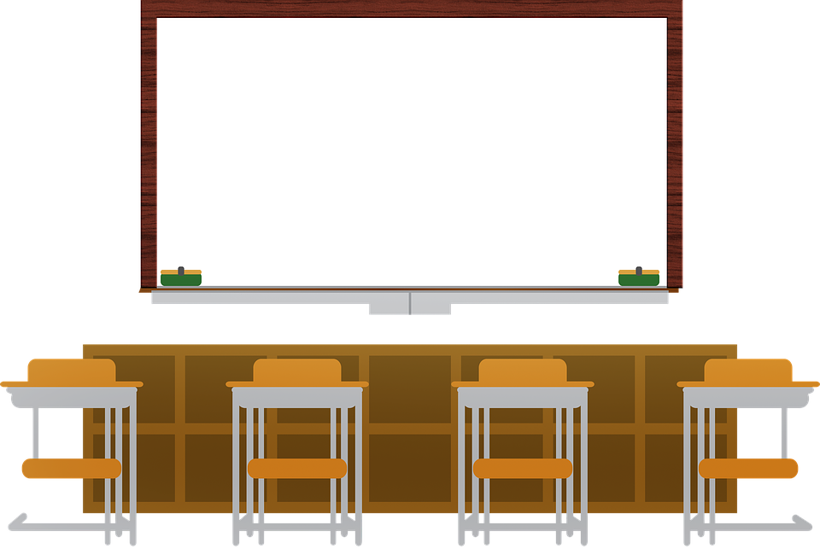
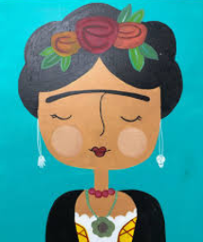
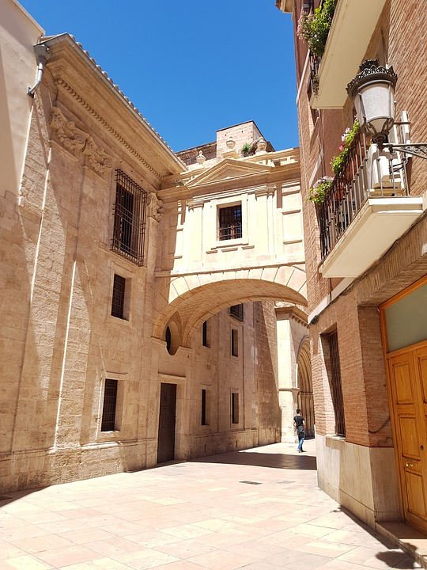



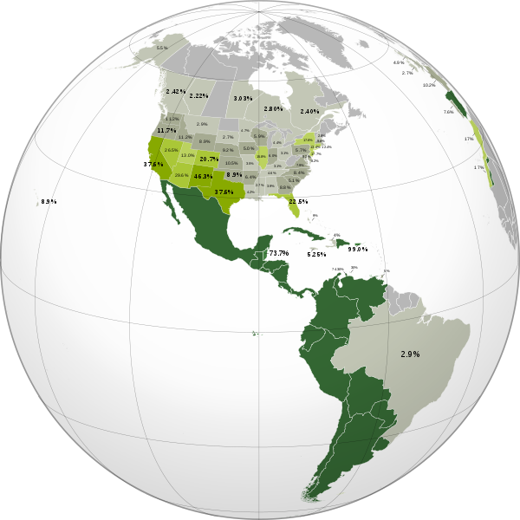



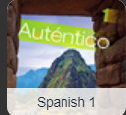



Syllabus
¡Bienvenidos a la clase de español!
Class Rules
¡Hola!,
Soy la maestra Clendaniel
Daily Agenda

Slide 2
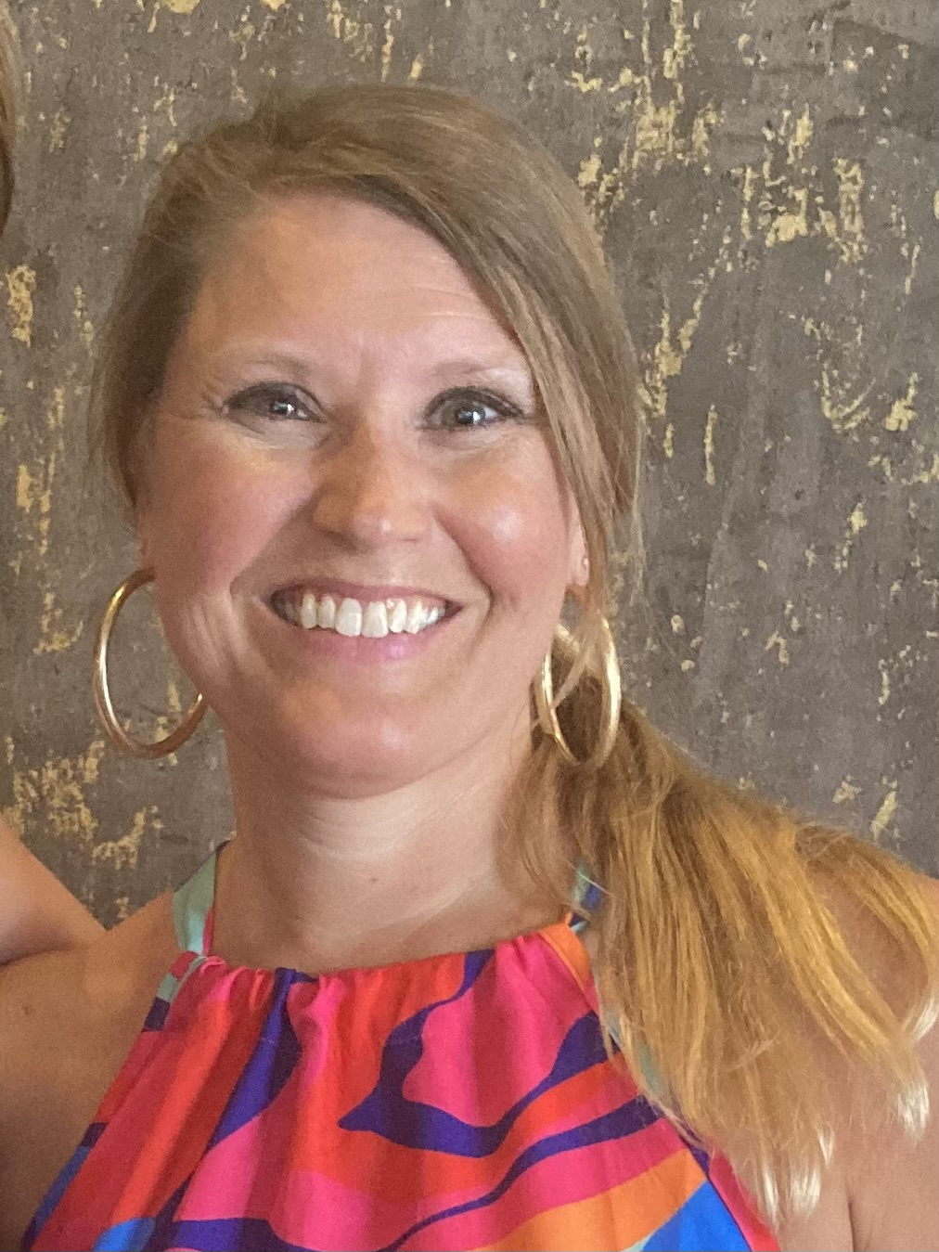
All about me
I grew up in Delaware. I attended Salisbury University and earned a BA in Spanish. Later, I attended Wilmington University to earn a Master’s in Education. I have lived in Savannah, Georgia, Hilton Head, South Carolina, Bluffton, South Carolina, and Due West, South Carolina. This is my fourth school year teaching in St. John’s County. I love learning and teaching Spanish! In my free time, I love going to the beach with my family.

Slide 3





Supplies
1 1inch Binder
7 dividers for beginners
12 dividers for intermediate
Pencils or pens
Index cards (Optional)

Slide 4
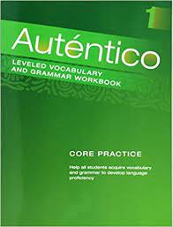



Textbook & Resources
Additional resources
These will be used daily
Text Book & Workbook
Main Communication Center

Slide 5

Structure
Students must adhere to student the code of Conduct
Attendance will be taken at the beginning of every class
Schoology
Daily Agenda
folder for lessons & assignments due
Calendar
All announcements
Skills used
Class rules
Listening
Speaking
Writing
Reading
Be on Time
Be prepared
Be polite
Be ready to think
Be open to new ideas
Be willing to take risks
Warm ups
Note taking
Skits
Homework is practice
Failure to follow class rules will result in the warning procedure:
Verbal warning
Student/Teacher Conference
Email home with documentation
Dean referral (Demerit)

Slide 6
Important Info:
All warm-ups are reviewed each day. I randomly select 1 warm-ups at to grade.
Students are required to keep an organized binder.
Students are notified of upcoming assessments verbally, on the board in class, update reminders in Schoology and on the calendar in Schoology.
Students may not submit formatives beyond one week of the due date for credit.
Make-up work takes much longer to grade than work submitted on time!
How can I help my child be successful in Intermediate Spanish?
Review the class expectations with your child. I will be addressing them in class, but your support at home is appreciated too!
Ensure sure he/she is here at school and has good attendance.
Remind your child to save socializing for before school, the hallways, lunch, and after school.
Stress the importance of respecting the teacher.
Empower your child to check Schoology for posted upcoming assignments and HAC for any missing assignments.
Encourage your child to study!!

Slide 7
Spanish Beginning Course Description:
The M/J Beginning Spanish course is an introductory course that presents vocabulary and grammar needed by beginning students to use in basic conversations. Students will also have the opportunity to learn about different cultural aspects related to the Spanish language from various countries. This course is modeled on the communicative approach where emphasis is placed on communicating a message through meaning-bearing input and structures output rather than just repetition ad rote memorization. While it is important for you to study vocabulary and produce the language, our approach will be directed toward the exploration and understanding of the language. Students are expected to use the target language every day and have fun exploring the Spanish language culture.

Slide 8
Spanish Intermediate Course Description:
The M/J Intermediate Spanish course is a continuation of M/J Beginning Spanish. We will expand on vocabulary and grammar and continue our communicative approach to learning by engaging in speaking, listening, reading and writing skills. Students will also have the opportunity to learn about different cultural aspects related to the Spanish language from various countries. Students are expected to use the target language every day and have fun exploring the Spanish language culture. At the end of this course, students who do very well in both Beginner and Intermediate Spanish can choose to earn a high school credit for level 1 Spanish.

Slide 9
SCHOOLOGY
The weekly agenda is posted Friday afternoons for the upcoming week.
All formatives and summatives are announced on the Schoology Calendar at least 3 days in advance.
Each chapter has a folder. All notes, review games, and classwork can be found under the chapter folder. For example: Capitulo 1A
I post review games for each vocab and grammar topic that we cover. These are a great study resource, but studying notes are the best resource.

Slide 10
Course at a Glance Beginning
Quarter 1: Para Empezar
1- En la escuela
2- En la clase
3- El tiempo
Quarter 2: Cap. 1 Mis amigos y yo
Capítulo 1A: ¿Qué te gusta hacer?
Capítulo 1B: Y tú, ¿cómo eres?
Quarter 3: Cap. 2 La escuela
Capítulo 2A: Tu dia en la escuela
Capítulo 2B Tu sala de clase
Quarter 4: Cap. 3 La comida
Capítulo 3A: Desayuno o almuerzo

Slide 12
STANDARDS
Both courses will cover the “main” standards of the language each day:
Standard 1 : INTERPRETIVE LISTENING:
The student will be able to understand and interpret information, concepts, and ideas orally from a variety of culturally authentic sources on a variety of topics in the target language.
Standard 2: INTERPRETIVE READING:
The student will be able to understand and interpret information, concepts, and ideas, in writing from a variety of culturally authentic sources on a variety of topics in the target language.
Standard 3: INTERPRETIVE COMMUNICATION:
The student will be able to engage in conversations and exchange information, concepts, and ideas orally and in writing with a variety of speakers or readers on a variety of topics in a culturally appropriate context in the target language.
Standard 4: PRESENTATIONAL SPEAKING
The students will be able to present information, concepts, and ideas to an audience of listeners on a variety of topics in a culturally appropriate context in the target language.
Standard 5: PRESENTATIONAL WRITING:
The students will be able to present information, concepts, and ideas to an audience of readers on a variety of topics in a culturally appropriate context in the target language.

Slide 13
Good Habits for a Successful Language Learner
Takes risks
  Is not afraid to speak
Respects the culture differentiation
  Is not ethnocentric & keeps an open mind
Listens carefully
Uses cognates often
  Words that sound alike, look alike and mean the same thing
Practices real world content
Memorizes vocab
  Spelling
  meaning

Slide 14

Contact Information
Allow 24 hours for a response
kelly.clendaniel@stjohns.k12.fl.us
Message me in schoology
Need help! I’m here for you ...

