Slide 2
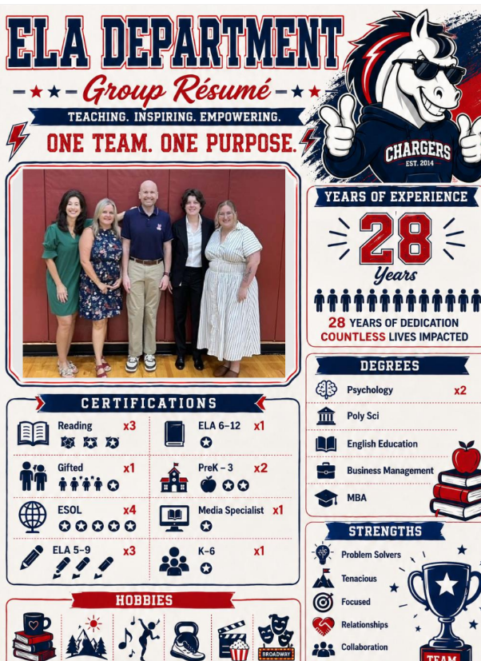
Team Members
Mr. Campbell
Mrs. Culpepper
Mrs. Jenkins
Mrs. Lovatt
Mrs. Monsanto

Slide 3
Schoology
Materials folder: Contains copies of notes and relevant resources
Updates: Used to send out reminders and for week ahead calendars
Messages: Please utilize this feature to reach out with any questions

Slide 4
Resources
Lexia: May be used at home to practice comprehension skills
Textbook: McGraw Hill SSO is located on the sidebar of the schoology page
Practice Tests: Prior to cold read summatives a practice test and self check key will be posted to assist with studying

Slide 5
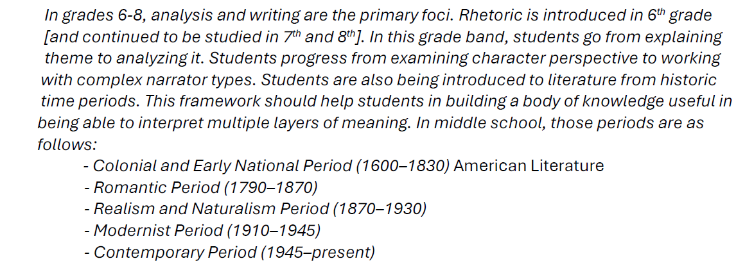
6th-8th Overview
6th Parent Guide
https://www.fldoe.org/core/fileparse.php/7539/urlt/pgg-6-standards.pdf
7th Parent Guide
https://www.fldoe.org/core/fileparse.php/7539/urlt/pgg-7-standards.pdf.
8th Parent Guide
https://www.fldoe.org/core/fileparse.php/7539/urlt/pgg-8-standards.pdf

Slide 6
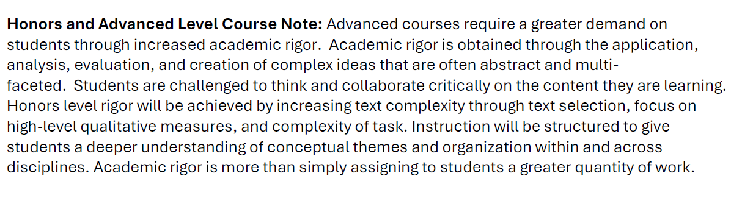
6th-8th Advanced Courses

Slide 7
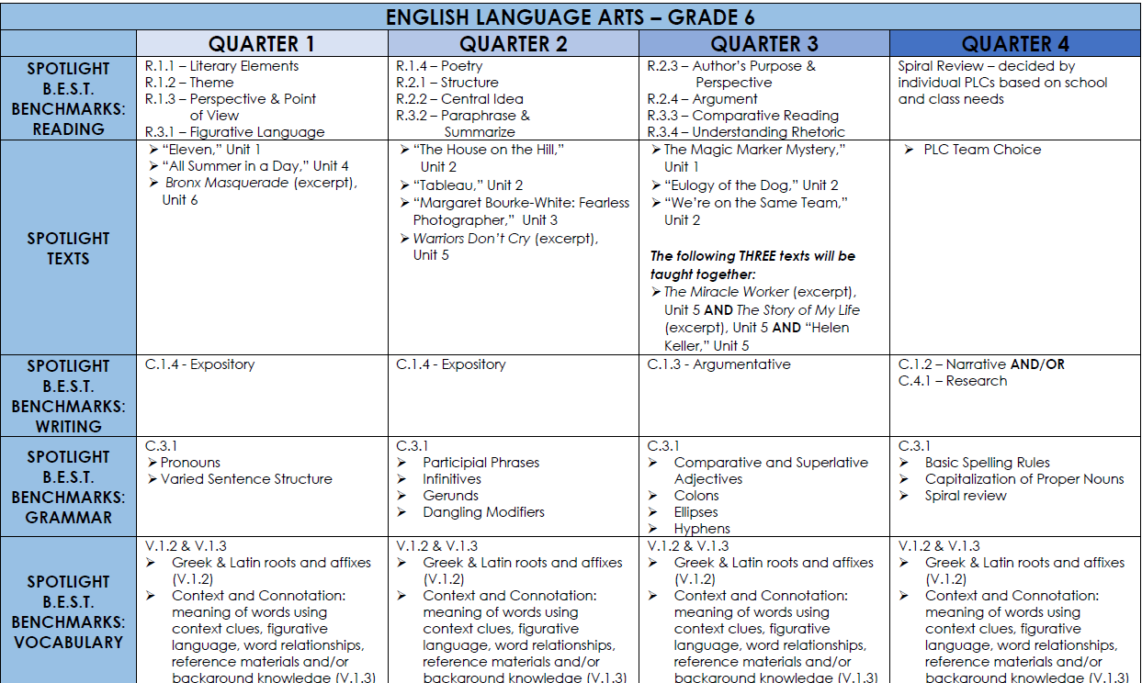
6th Grade Overview

Slide 8
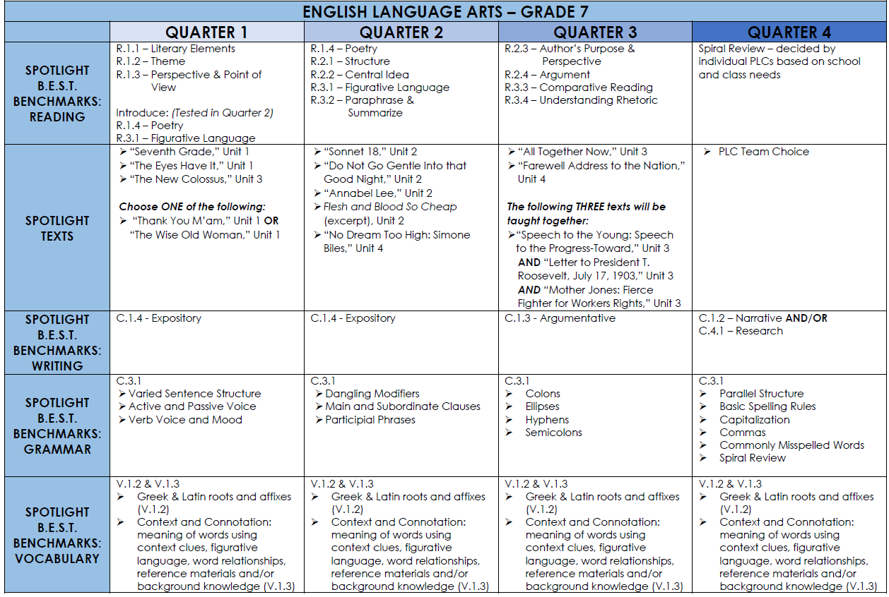
7th Grade Overview

Slide 9
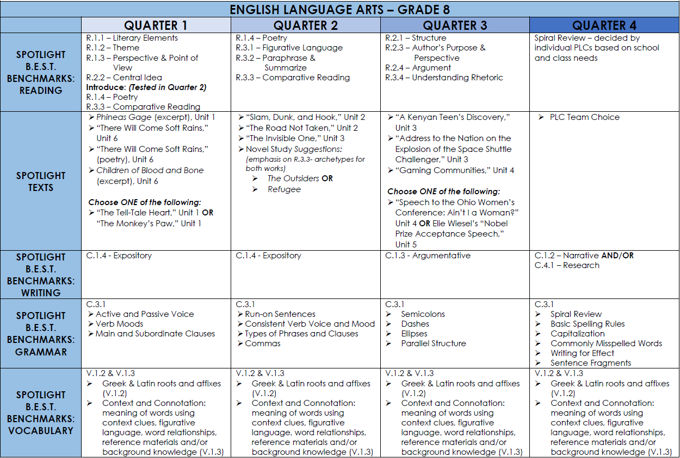
8th Grade Overview

Slide 10
Contact Information
Mr. Campbell - Stephen.Campbell@stjohns.k12.fl.us
Mrs. Culpepper - Eileen.Culpepper@stjohns.k12.fl.us
Mrs. Jenkins - Lex.Lacy-Jenkins@stjohns.k12.fl.us
Mrs. Lovatt – Sarah.Lovatt@stjohns.k12.fl.us
Mrs. Monsanto - Kylie.Monsanto@stjohns.k12.fl.us

