Slide 1

Patriot Oaks Academy
Middle School Physical Education
2026-2027
Coach Brossart
Coach Monsanto

Slide 2
Brossart’s Schedule:
1st – Planning
2nd – 6th Grade PE
3rd – 7th Grade PE
4th – 6th Grade PE
5th – 7th Grade PE
6th – 6th Grade PE
7th – 7th Grade PE
Monsanto’s Schedule:
1st – Planning
2nd – 7th Grade PE
3rd – 8th Grade PE
4th – 8th Grade PE
5th – 8th Grade PE
6th – 8th Grade PE
7th – 7th Grade PE

Slide 3
Brossart’s Bio:
From: Dowagiac, MI
Years Teaching: Double Digits
Years at POA: Since the beginning
Favorite Sports Team: Notre Dame, Cincinnati Bengals, Boston Celtics
Monsanto’s Bio:
From: Palm Coast, FL
Years Teaching: 6
Years at POA: 4
Favorite Sports Team: Liverpool FC

Slide 4

Earning Grades
Class Preparedness – Dressed in P.E. uniform and appropriate footwear to participate
Participation – Engaged in the daily lesson to demonstrate knowledge of activity/game/sport
Notebook – All students will be expected to maintain an ISN – Interactive Student Notebook as described
Fitness Testing – Fitness activities to improve all areas of health-related fitness
Students that do not dress for class or are not actively participating will be required to complete an alternate assignment relevant to the activity or concept to earn participation points for that class period.

Slide 5
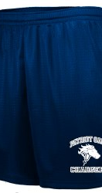
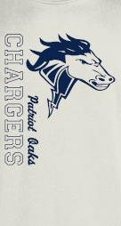
Dress Out
  Need:
    POA PE Shirt
    POA PE Shorts
    Athletic Shoes
  If you need to purchase, you may do so through SchoolPay
    $15 – Shirt
    $10 – Shorts
  We will dress out Every Single Day of the School Week Except Wednesday

Slide 6

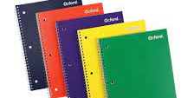
Interactive Notebook
Need Notebook and Pencil dedicated to PE, leave in PE Locker
Used for:
  Tracking Progress on Fitness Scores
  Setting Goals
Students will receive grades for notebook checks

Slide 7
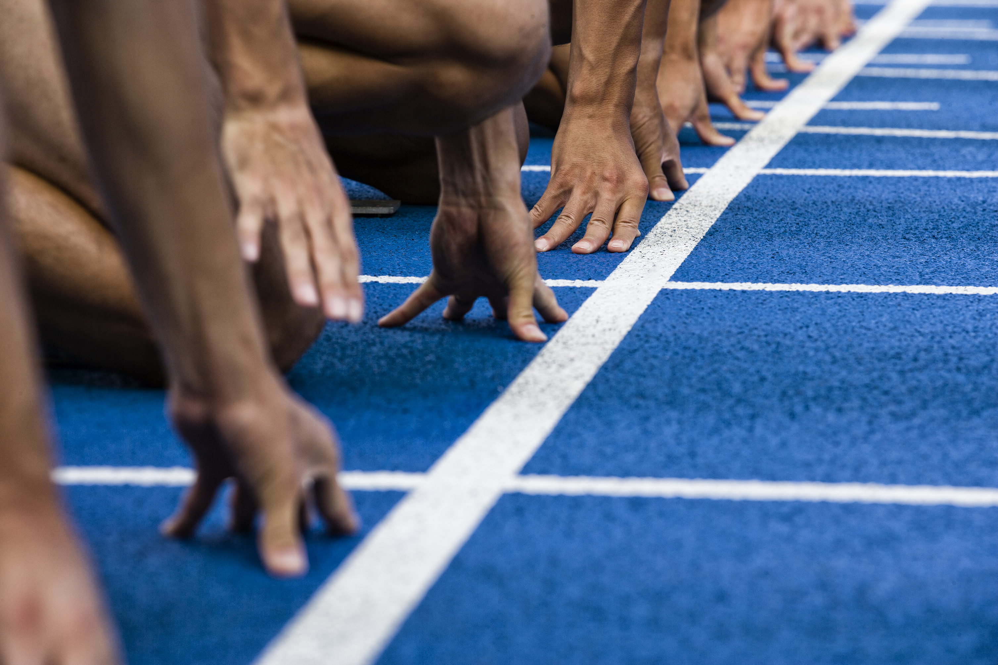
Fitness Testing
We will practice and test in the following areas throughout the year and student’s will track their progress in their notebooks:
Half Mile – Cardiorespiratory Endurance
Mile – Cardiorespiratory Endurance
20 Meter Pacer – Cardiorespiratory Endurance
Push Ups – Muscular Endurance
Planks – Muscular Endurance
Sit/Reach - Flexibility
Sit Ups – Muscular Endurance

Slide 8

Schoology
Materials Folder Will Contain Items Such As:
  Syllabus
Messages:
  Please utilize this feature to reach out to your PE Teacher with any questions.
Updates:
  These will be used to send out important information for the class

Slide 9
Contact Information
  Coach Brossart – Amanda.Brossart@stjohns.k12.fl.us
  Coach Monsanto – Nicholas.Monsanto@stjohns.k12.fl.us
  Messages can also be sent through Schoology.
  Feel free to reach out if you have questions.

