Slide 1

Welcome to the Middle School Math Open House

Slide 2

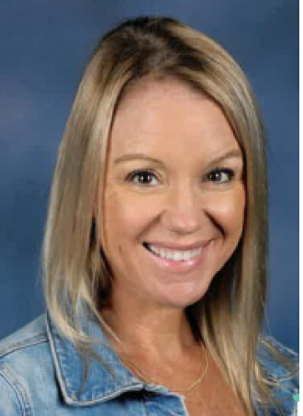



Meet the Math Department Team:
Mrs. Hicks
6th Standard
7th Advanced
8th Pre-Algebra
Mrs. Greenfield
7th Standard
7th Advanced
Mrs. Orr
Algebra 1 Honors
Mrs. Aravamudan
6th Advanced
Geometry Honors

Slide 3


Slide 4
Schoology
The expectation is that students and families regularly access Schoology to check the following sections for information:
Materials- Check the GREEN folder for the current weeks materials.
Calendar- For upcoming assessments.
Updates Page- Any important announcements.
Messages- Your child is able to message me with any questions/concerns.

Slide 5
Math Nation Online Textbook
Students access the online textbook through Clever by clicking the
accelerate learning icon.
Select the correct textbook and corresponding unit and section to view the student lesson which includes videos and extra practice opportunities.

Slide 6
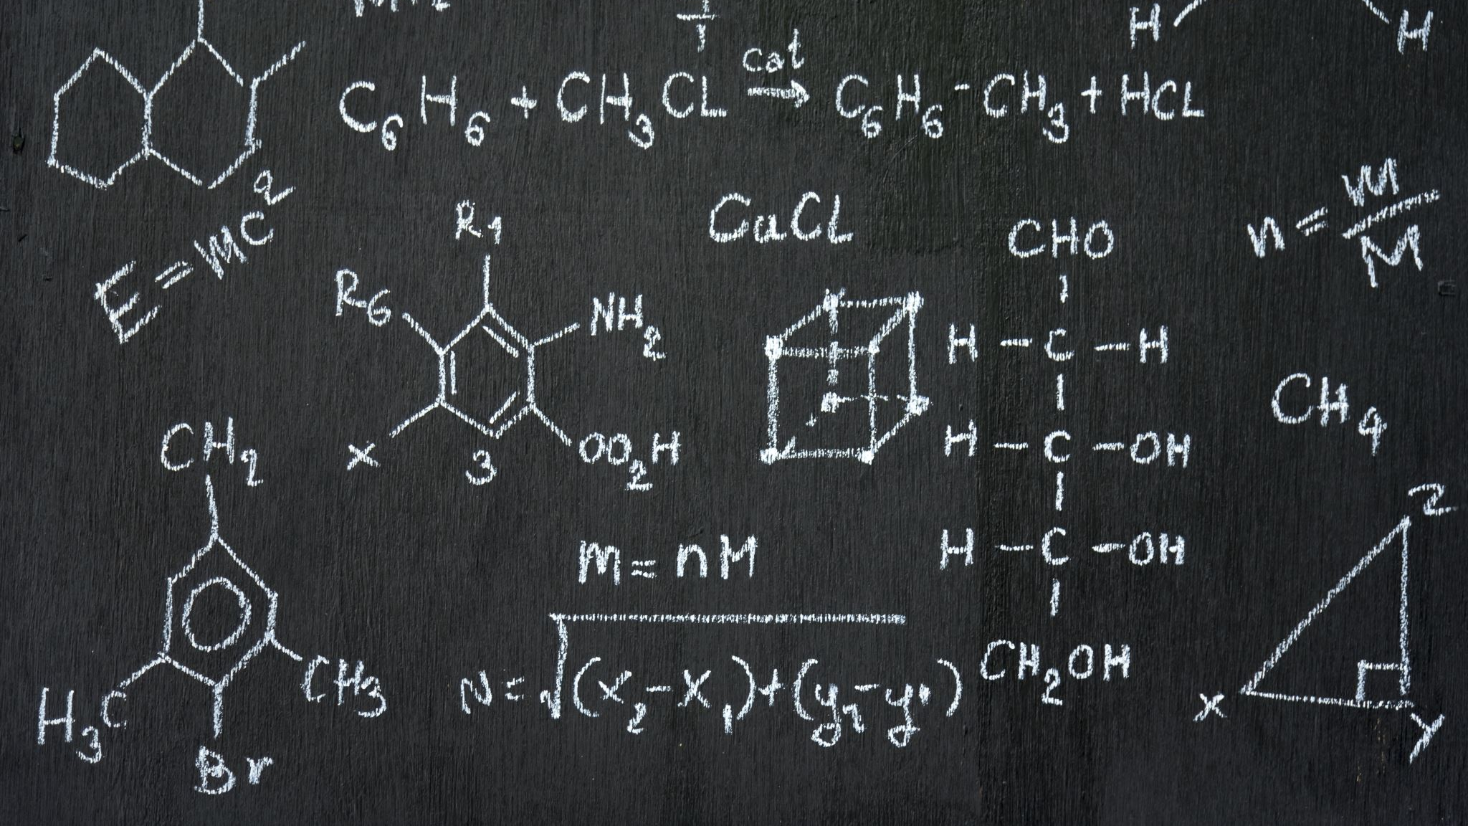
6th Grade
1st Quarter
Number Sense and Operations with Positive Numbers (Unit 1)
Fractions, Decimals, Percents (Unit 2)
Understanding Rational Numbers (Unit 3)
3rd Quarter:
Representing Data and Data Distributions (Unit 10)
Algebraic Expressions (Unit 13)
Equations and Inequalities (Unit 14)
2nd Quarter
The Coordinate Plane (Unit 4)
Operations with Integers (Unit 6)
Data Sets (Unit 9)
4th Quarter:
Area (Unit 7)
Surface Area and Volume (Unit 8)
Ratios and Rates (Unit 5)
Review for F.A.S.T.

Slide 7
^{7th} Grade
1st Quarter
Probability (Unit 2)
Operations with Rational Numbers (Unit 3)
Area (Unit 4)
3rd Quarter:
Evaluating Numeric Expressions (Unit 8)
Algebraic Expressions (Unit 9)
Equations and Inequalities (Unit 10)
2nd Quarter
Scaling with Proportional Relationships (Unit 5)
Solving Muli-Step Problems with Proportional Relationships (Unit 6)
Solving Percentage Problems with Proportional Relationships (Unit 7)
4th Quarter:
Representing Proportional Relationships (Unit 11)
Surface Area and Volume (Unit 12)
Numerical and Categorical Data (Unit 13)
Review for F.A.S.T.

Slide 8
7th Advanced/8th Pre-Algebra
1st Quarter
Inequalities/Equations (Unit 1)
Real Number System (Unit 2)
Exponent Rules/Scientific Notation (Unit 3)
Solving Problems with Rational Numbers (Unit 4)
3rd Quarter:
Functions (Unit 12)
Representing Data (Unit 13)
Equivalent Algebraic Expressions (Unit 14)
2nd Quarter
Proportional/Non-Proportional Relationships (Unit 5)
Relationships with Triangles (Unit 6)
Linear Relationships (Unit 10)
Solving Equations and Systems of Equations (Unit 11)
4th Quarter:
Transformations (Unit 15)
Properties and Theorems of Angles (Unit 16)
Probability (Unit 17)
Review for F.A.S.T.

Slide 9
Algebra 1 Honors
1st Quarter
Solving Equations (Unit 5)
Introduction to Functions (Unit 1)
Algebraic Expressions (Unit 2)
Linear Functions (Unit 3)
3rd Quarter:
Rewriting Polynomial Expressions (Unit 7)
Quadratic Functions (Unit 8)
Writing and Solving Quadratic Equations (Unit 9)
Absolute Value Functions (Unit 10)
2nd Quarter
Linear Functions (Unit 3)
Key Features of Linear Functions (Unit 4)
Solving Equations (Unit 5)
Linear Inequalities (Unit 6)
4th Quarter:
Exponential Functions (Unit 11)
Bring it Together (Unit 13)
Data Displays and Categorical Data (Unit 12/14)
Review for EOC

Slide 10
Geometry 1 Honors
1st Quarter
Geometric Reasoning (Unit 1/2)
Logic and Line Relationships (Unit 3)
Transformations and Symmetry (Unit 4)
3rd Quarter:
Quadrilaterals (Unit 7)
Similarity (Unit 8)
Right Triangles and Trigonometry (Unit 9)
2nd Quarter
Transformations and Symmetry (Unit 4)
Triangles and Congruence (Unit 5)
Relationships in Triangles (Unit 6)
4th Quarter:
Circles (Unit 10)
Geometric Measurement (Unit 11)
Review for EOC

Slide 11
Questions?
If you have a specific need/concern that needs addressed, please email me.
Kelly.hicks@stjohns.k12.fl.us
Sara.greenfield@stjohns.k12.fl.us
Kylee.orr@stjohns.k12.fl.us
Usha.Aravamudan@stjohns.k12.fl.us

