Slide 1

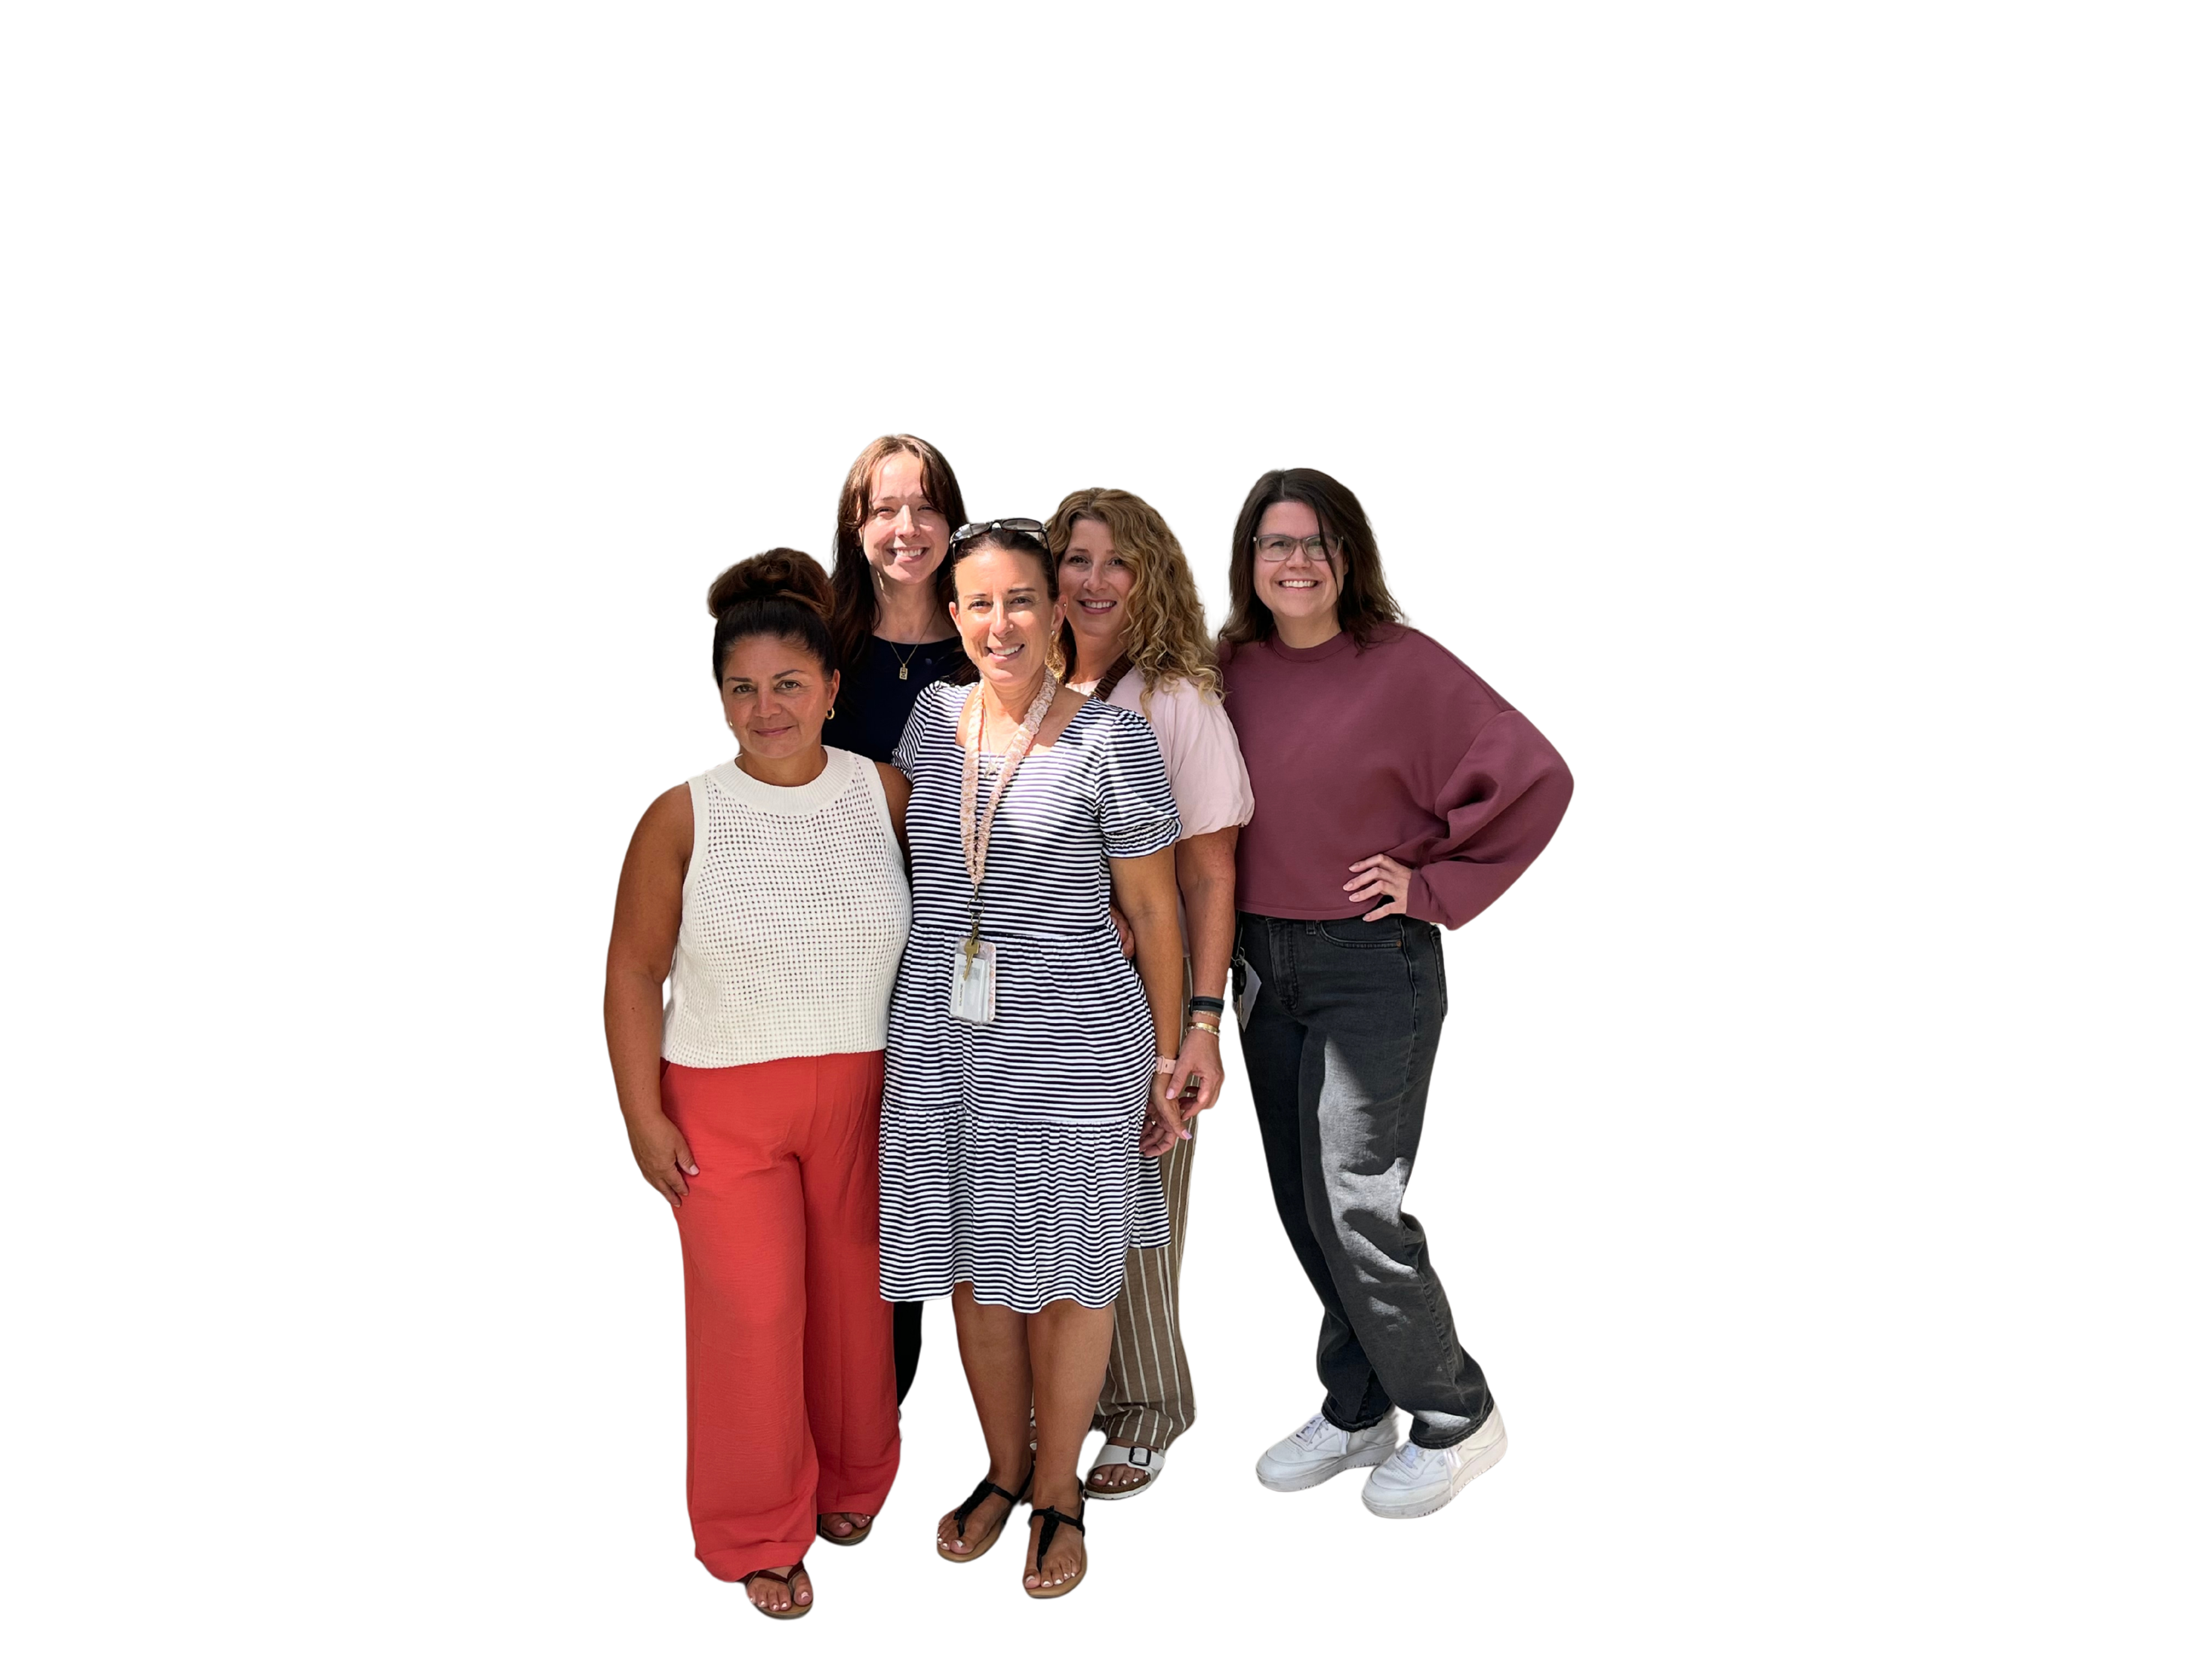
meet our team
EXCEPTIONAL STUDENT EDUCATION,
VARYING EXCEPTIONALITIES
Our team works with students who have Individualized Education Plans, ensuring they are receiving appropriate services and accommodations to reach their goals.
CONTACT US
Katherine.McCullough@stjohns.k12.fl.us
Tylor.Craven@stjohns.k12.fl.us
Lisa.Winter@stjohns.k12.fl.us
Kerianne.Contuzzi@stjohns.k12.fl.us
Lisa.Salamone@stjohns.k12.fl.us
Heather.Dunham@stjohns.k12.fl.us
Elementary
Keri Contuzzi
Lisa Salamone
Heather Dunham
Middle
Ty Craven
Lisa Winter
Katie McCullough

