Slide 1


WElCOME TO MIDDLE SCHOOL ART
Jodi Lubrant
Middle School Art Teacher

Slide 2
About art classes
I teach Art 1 (6th ) Art 2 (7th ) and Art 3 (8th) Advanced Art (7th, 8th), All our lessons are based on the elements Of art and the Principles of design which is what is taught k-after college. I teach those to all my classes but with different projects that differentiate between the 5 levels, Art 1 6th, Art 2 7th plus Art 2 Advanced, Art 3 8th plus art 3 advanced from easier to more difficult. I let the more advanced students take it beyond that. I try to set everyone up for success in art. This room should be the place that they can come and relax, enjoy art, their friends and give the right side of the brain a break. Although we do have project deadlines as well as formative and summative assessments, they are all project based at this time. Formatives are sketchbook assignments, note taking on projects, and thumbnail ideas (brainstorming, practicing) for final project, including SOME LESS ADVANCED PROJECTS. Summatives are the final projects with all the components from starting in sketchbooks to self evaluations at the end. I use the grading rubrics to grade these that will be in another slide for you to view.

Slide 3
Expectations for art class
The following rules apply to all POA middle school art classes.
* Each student will respect and use , in a safe manner, all materials, tools, and equipment needed to create the art assignment.
*Each student will return all materials and tools to the assigned storage areas.
*Removing any tools or supplies from the art room is unacceptable and will result in a visit to the Dean or a Step.
*Students will be respectful of each others, the materials, the art room, school policies and procedures, and all artwork.
*Be relaxed, enjoy creating art with your friends, and know you will always be successful in my class if you do your best. There are only “Happy Mistakes” in art.

Slide 4
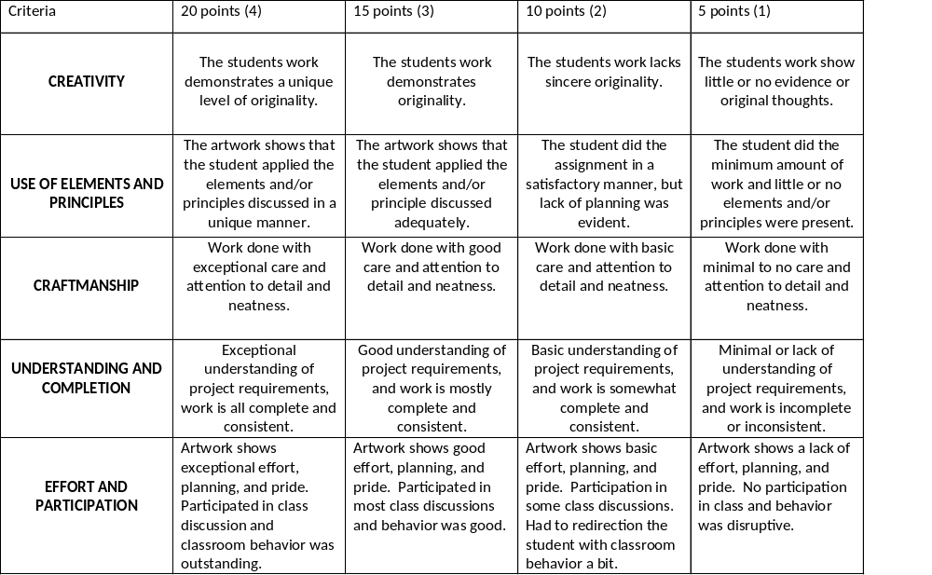
Grading Rubrics

Slide 5
Grade expectations
I believe everyone should be able to enjoy art and be successful at all skill levels. Grading is based on understanding of the concepts being taught, CREATIVITY, USE OF ELEMENTS AND Principles of design, craftmanship (neatness), effort, participation, and completion.

Slide 6

Schoology
At this point, all I have on Schoology Is a weekly agenda that shows what we are doing each week. If we use any links or if there is anything else I need to communicate to the students I will do it on Schoology. Students can message me on Schoology if they need anything. To get to the weekly agenda, go to their course, materials, quarter weekly plans. Each week should be up there for students to view.

Slide 7
Student artwork
I will be keeping all artwork until the end of the year to display AND choose what artwork will be displayed in the schoolwide art show to showcase all the talent throughout the school. If you would like to see what your child is doing, they may take pictures or I can take a picture and send it to you. I’m so excited to showcase all the talent we have here at POA. I am really impressed with all the students.

Slide 8

Supplies
I am requiring every student to get a specific sketchbook. We will keep the sketchbooks and pencils/erasers in class, so they don’t get lost. We are also collecting a supply fee of $30 for all the rest of the supplies need for art class including, paint pens, oil and chalk pastels, drawing, multimedia, and watercolor paper, watercolor paints, acrylic paints, glue, markers, colored pencils, clay, glazes, and any other speciality supplies needed for a successful year. The link to pay is in schoolpay on POA website.
Michaels: Hardbound or Spiral sketchbook by Artist Loft 8.5x11
OR
Amazon: SAME AS MICHAELS FOR SKETCHBOOK
Hardbound 8.5x11 solid or spiral sketchbook

Slide 9

Projects
All projects are based on the elements of art and the principles of design
Elements of art include: line, shape, form, space, color, value, texture.
Principles of design include: balance, contrast, emphasis, movement, pattern, rhythm, unity.
The elements are what we are using and the principles are how we are using them.

Slide 10
If you need to contact me at any time, email is the easiest and quickest way. If we need to speak about anything, we can arrange a phone call at that time. If you have any questions, please feel free to email me.
Thank you for your support,
Jodi Lubrant
Middle School Art Teacher
Patriot Oaks Academy
Jodi.lubrant@stjohns.k12.fl.us

