Slide 1



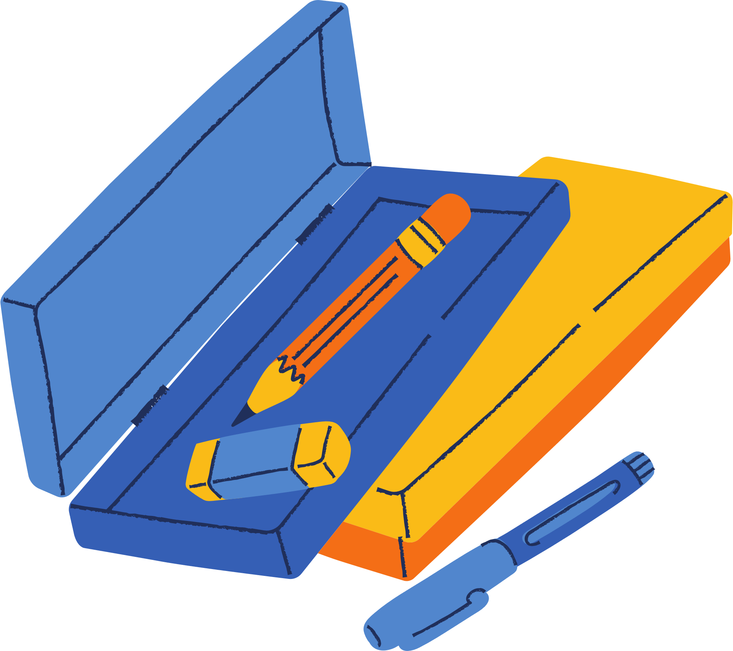


MIDDLE SCHOOL 101
Welcome Back Students & Parents!

Slide 2

WELCOME TO MIDDLE SCHOOL!
Today, we will cover...
  Schoology Access and Expectations
  Re-testing and Testing Calendar
  Grading Policy
  PBIS Rewards

Slide 3
SCHOOLOGY EXPECTATIONS
It is expected that Schoology is used by both the teacher and the students in the following ways...
  Teachers will instruct students on how to use Schoology
  Teachers will utilize Schoology to communicate with families, WEEKLY.
  Teachers will utilize a school-specific organizational system to post resources for students and families in Schoology.

Slide 4
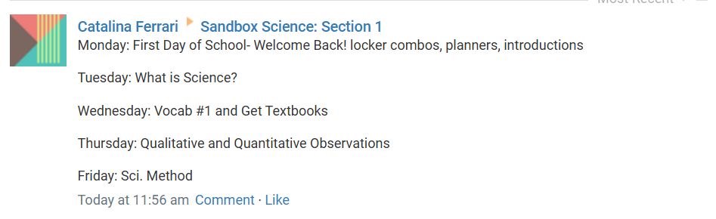
UPDATES ON SCHOOLOGY
For the sake of simplicity, all teachers at POA will be using the same format.
All updates will be at the top of your materials page for each class. It will be the students weekly agenda. Please note that the weekly agenda on Schoology can change at any point during the week.

Slide 5
SCHOOLOGY SET UP
All POA teachers should have a relatively similar set-up with one another
  The current week should be showing as a GREEN folder.
  All past weeks should be showing as a GRAY folder.
  There might be an additional folder at the top with supplemental information (textbook PDFs, test correction format, etc.), this will be any color the teacher chooses.

Slide 6
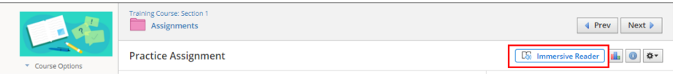
IMMERSIVE READER
If your student would like, there is an immersive reader option for ALL Schoology assignments.
Students just need to click the play button for it to start.
They can adjust the speed, voice, text size, and other preferences.

Slide 7
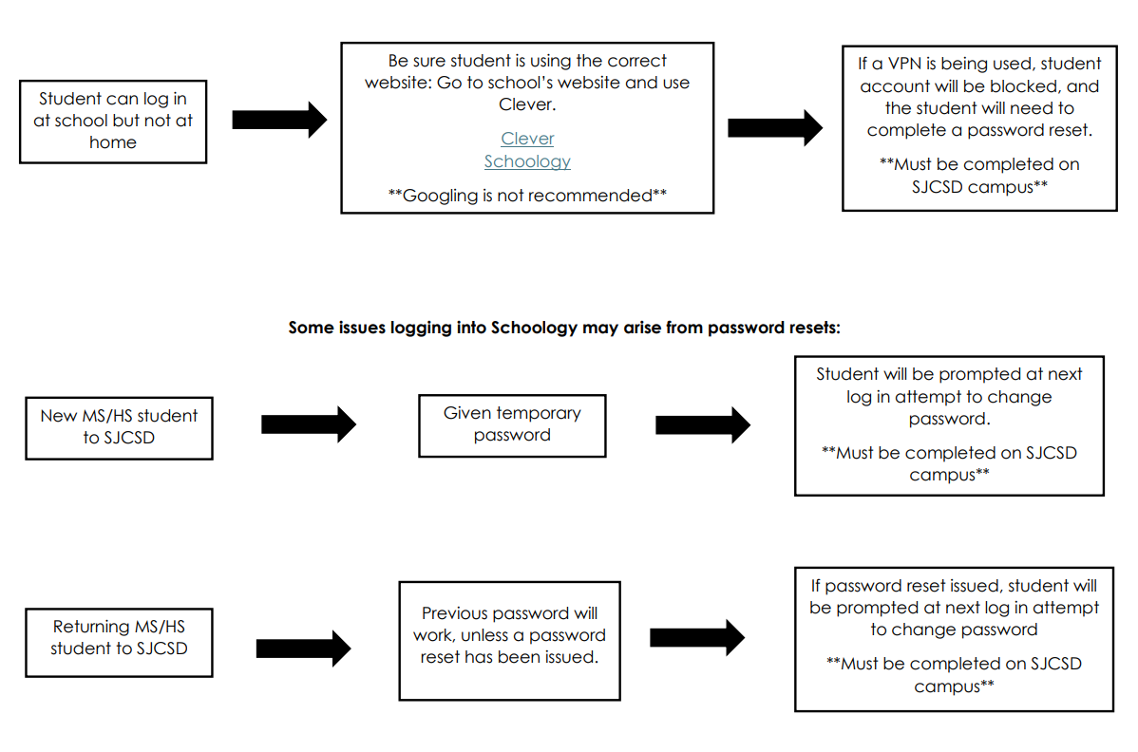
PASSWORD RESET

Slide 8

TESTING CALENDAR
All teachers will be utilizing the testing calendar on Schoology. This will help to ensure that students do not have too many test on the same day. Please ensure that you are checking their calendar on their profile to see what is due and when it is due.

Slide 9

RE-TESTING DAYS
The re-test days are as follows. Please make sure your student knows that they need to have a conversation with their teacher about this BEFORE they come in for the retake.
  Monday- Social Studies
  Tuesday- Math
  Wednesday- Electives
  Thursday- Science
  Friday- ELA

Slide 10
POA GRADING POLICY
This grading information is for FORMATIVE assignments.
  Students may earn up to 100% BY THE DUE DATE.
  Can submit work up to 1 week for an 85%.
  If submitted after one week but credit = 0% (will go into the gradebook as an INC).
  Students MUST redo ALL formatives in order to retake a summative.

Slide 11
POA GRADING POLICY
This grading information is for SUMMATIVE assignments.
  Students may earn up to an 85% after retaking a summative.
  ALL formatives must be COMPLETED and seen by the teacher before retaking the summative.
  Some teachers may have a test correction format the student will need to complete as well.
  Students MUST have a conversation with their teacher before retesting.

Slide 12
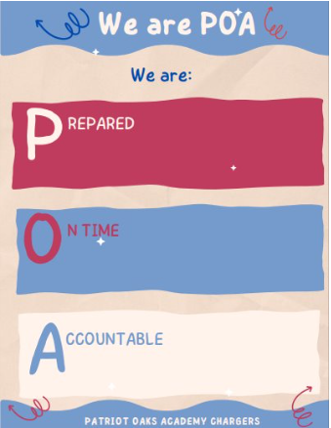
PBIS
Middle school students will have the chance to earn PBIS points by showcasing that they follow the POA way.
Students can check their points balance in their PBIS account.

Slide 13
PBIS REWARDS
Students will ahve the opportunity to use their PBIS points to “shop” in the PBIS store.
  Some teachers have their own PBIS stores.
  The Charger Store will go live once a month.
  Students can also purchase events such as tickets to basketball and volleyball games, skip the lunch line pass, breakout sessions, and more.

Slide 14
School PE Uniforms
All middle school students must have a Patriot Oaks Academy PE Uniform. There are no substitutes other than the approved uniform.
If you haven’t already done so, purchase yours from the Welcome Back email Mr. Chiodo sent out earlier this week. Students will receive their uniforms from their PE Coaches!

Slide 15
QUESTIONS?

